Slide 1
Lecture 7a Solving Recurrence Relations 1

Slide 2
Recall: Solving a Recurrence Relation
2
Solving a recurrence relation – finding an explicit formula that defines the same sequence
Solution to a recurrence relation not always exists
We will study 5 methods for solving recurrence relations

Slide 3
Five Methods
3
Guess + Prove by Induction
Telescoping a Sum
Substituting
Solving homogeneous/inhomogeneous recurrence relations
Master Method
only the order obtained, not the precise formula (technically not solution)

Slide 4
Guess + Prove by Induction
4
Start from the initial conditions
Calculate a few successive terms until seeing a pattern
Guess the explicit formula
Prove the explicit formula by Induction

Slide 5
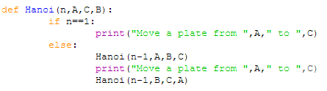
Example: Towers of Hanoi
1, n=1
m_{n} = moves
2m_{n-1} + 1, n>1
0, n=0
Or m_{n} = [modified if statement]
2m_{n-1} + 1, n>0

Slide 6
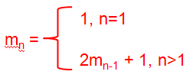
Guess + Prove by Induction
0, n=0
Or m_{n} = 2m_{n-1} + 1, n>0
moves
n | (0) | 1 | 2 | 3 | 4
m_{n} | (0) | 1 | 3 | 7 | 15
Guess formula: …
Prove formula: …
6
Example: Towers of Hanoi

Slide 7
Guess + Prove by Induction
0, n=0
Or m_{n} = 2m_{n-1} + 1, n>0
moves
n | (0) | 1 | 2 | 3 | 4
m_{n} | (0) | 1 | 3 | 7 | 15
Guess formula: … m_{n} = 2^{n}-1, ∀n≥1 (∀n≥0)
Prove formula: …
7
Example: Towers of Hanoi

Slide 8
Recall: Example: Program 2 (recursive) to calculate Factorial
def facRec(n):
if n ==0:
return 1
else:
return facRec(n-1) *n
0, n=0
m_{n} = multiplications
m_{n-1} + 1, n>0

Slide 9
Recall: Program 1 (recursive) to calculate Factorial
0, n=0
m_{n} = multiplications
m_{n-1} + 1, n>0
n | 0 | 1 | 2 | 3 | 4
m_{n} | 0 | 1 | 2 | 3 | 4
Guess formula: …
Prove formula: …
9

Slide 10
Recall: Program 1 (recursive) to calculate Factorial
0, n=0
m_{n} = multiplications
m_{n-1} + 1, n>0
n | 0 | 1 | 2 | 3 | 4
m_{n} | 0 | 1 | 2 | 3 | 4
Guess formula: … m_{n} = n, ∀n≥0
Prove formula: …
10

Slide 11
Recall: Example: Program 2 (recursive) to calculate Factorial
def facRec(n):
if n ==0:
return 1
else:
return facRec(n-1) *n
1, n=0
t_{n} = multiplications + subtractions
t_{n-1} + 2, n>0

Slide 12
Recall: Program 1 (recursive) to calculate Factorial
1, n=0
t_{n} = multiplications + subtractions
t_{n-1} + 2, n>0
n | 0 | 1 | 2 | 3 | 4
m_{n} | 1 | 3 | 5 | 7 | 9
Guess formula: …
Prove formula: …
12

Slide 13
Recall: Program 1 (recursive) to calculate Factorial
1, n=0
t_{n} = multiplications + subtractions
t_{n-1} + 2, n>0
n | 0 | 1 | 2 | 3 | 4
m_{n} | 1 | 3 | 5 | 7 | 9
Guess formula: … m_{n} = 2n+1, ∀n≥0
Prove formula: …
13

Slide 14
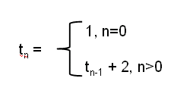
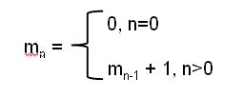
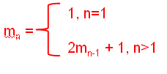
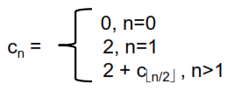

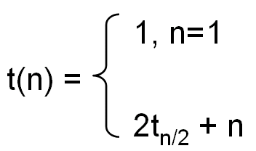
Telescoping a Sum
1
Factorial (multiplications, time)
Hanoi
Binary search
Max subsequence sum algorithm 3
2
3
4
14

Slide 15
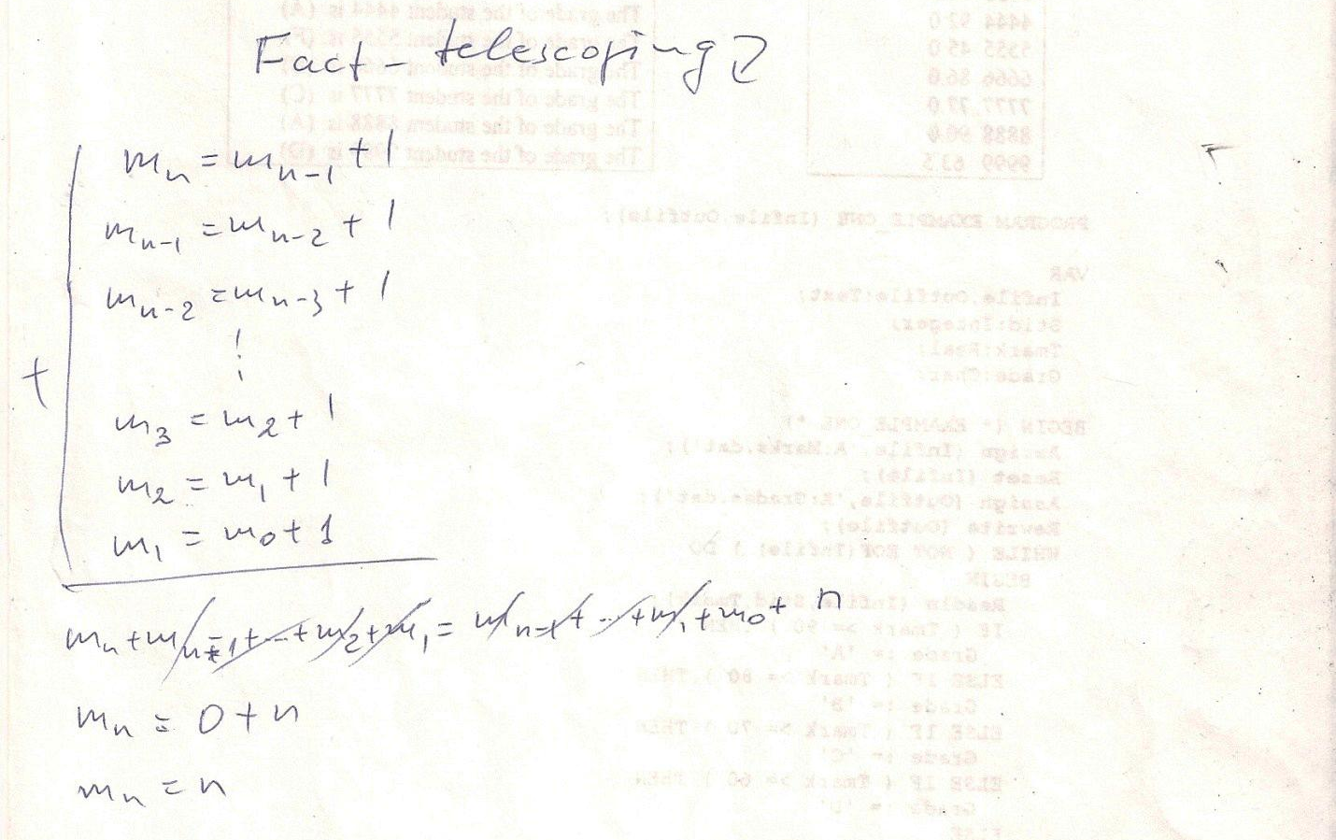
15

Slide 16
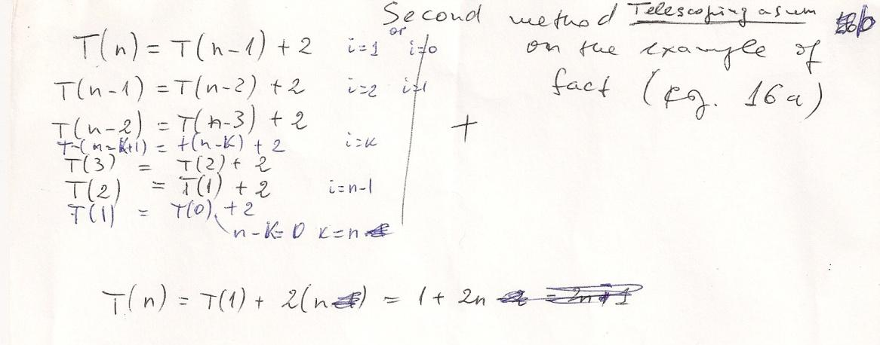
Factorial - operations
16

Slide 17
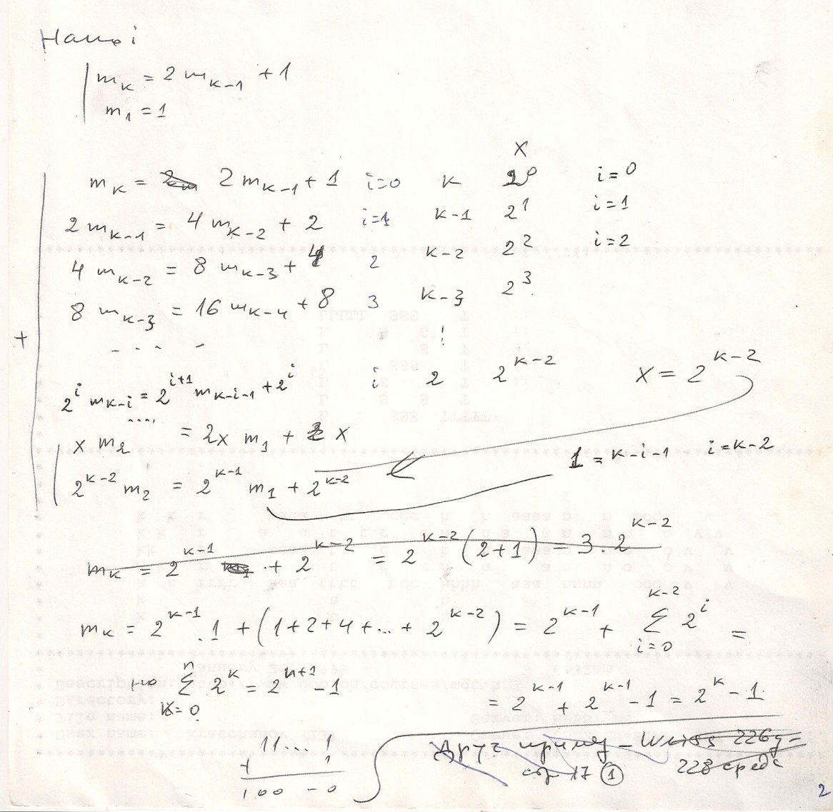

17

Slide 18
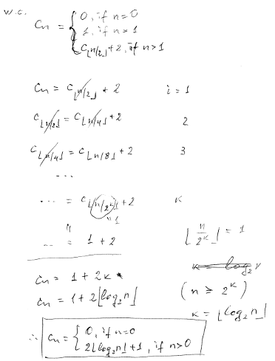

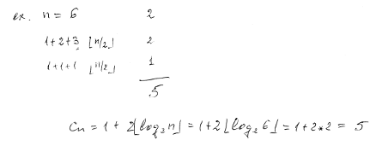
Binary search
2
6
c_{n}=2+2⎣log₂n⎦=2+2⎣log₂6⎦=2+2*2=6
2
2
2
2
2
18

Slide 19
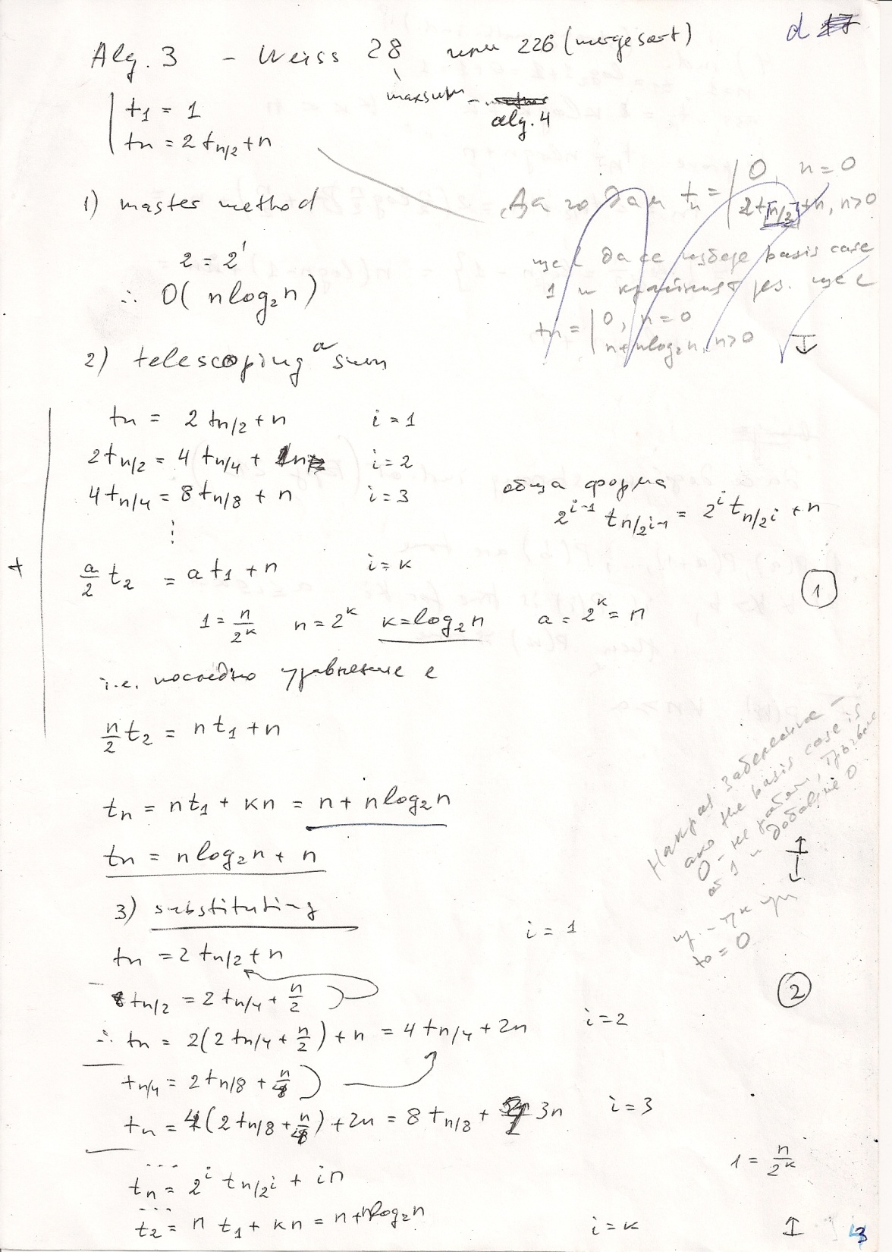
Max subsequence sum
19
or t_{n} = n(1+log₂n) = nlog₂2n

